Slide 1

Capstone Project Assignment
Aly6140: Analytics system technology
Project Name: Heart Failure Prediction
Team members in group 5
Mayank Kumar Pandey
Urvashi Sharma
Rupali Metkari
Date: 6/4/2021
Professor: Varsha Kulkarni

Slide 2
Index
Problem Statement
Introduction
Steps followed for Data Analysis
Results
Conclusion
Appendix

Slide 3
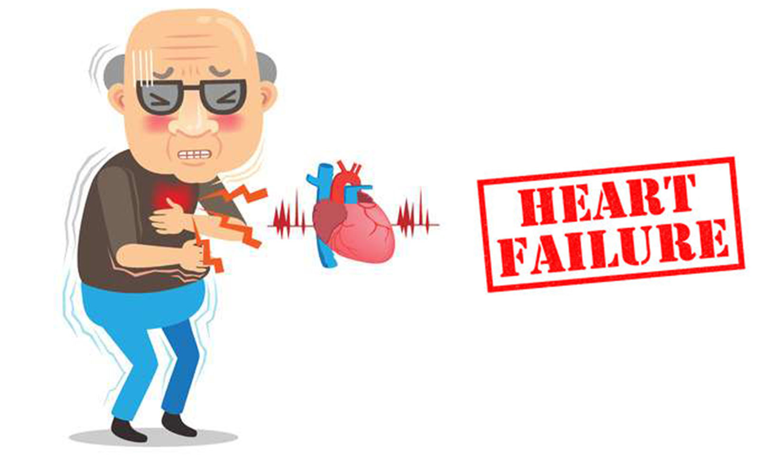
Problem Statement
Predict the survival of each patient having heart failure symptoms and to detect the most important clinical features (or risk factors) that may lead to heart failure. By applying exploratory data analysis on the heart failure clinical records dataset,
Below are the questions that needs to be considered: Q1. What are the correlations between the different variables of the dataset? Q2. What is the number of deaths due to heart failure vs survival of the patient? Q3. What is the death events of the patients based on Age and sex? Q4. What is the impact of diabetes on the heart failure of the patients? Q5. What is the impact of smoking on the heart failure of the patients?

Slide 4
Introduction
We are using heart failure dataset. We use python for data analysis and machine learning algorithm. We predict whether a particular person has a heart disease or not based on the attributes of dataset and find various insights from this dataset which could help in predicting the reasons of a heart disease which could led to death.
This is multivariate type of dataset which means providing or involving a variety of separate mathematical or statistical variables and data analysis.
Dataset link: http://archive.ics.uci.edu/ml/datasets/Heart+failure+clinical+records#

Slide 5

Steps followed for Data Analysis:
Install libraries: pandas, numpy, matplotliob, and seaborn
Import Dataset- Here we imported heart_failure_clinical_records.csv.
Clean Data - This dataset having 299 rows and 13 variables. We checked for null/missing or inappropriate values in the dataset.
Creating Correlation Matrix: Correlation indicates how the features are related to each other or to the target variable. Heatmap makes it easy to classify the features are most relevant to the target variable. We plotted the correlation matrix of the dataset and later found which attribute were highly correlated to death event.
Data Visualization: Used seaborn library to create multiple graphs and plot of the dataset which helped us to understand the dataset and draw preliminary conclusions.

Slide 6

Steps followed for Data Analysis:
6. We finally used sklearn to create a model of the dataset. We used logistic regression and Random Forest to create the model.
Gathered columns.
Splitting Dataset into train and test data.
Creating the model using logistic regression.
Prediction using the model.
Model Evaluation using Random Forest algorithm.

Slide 7
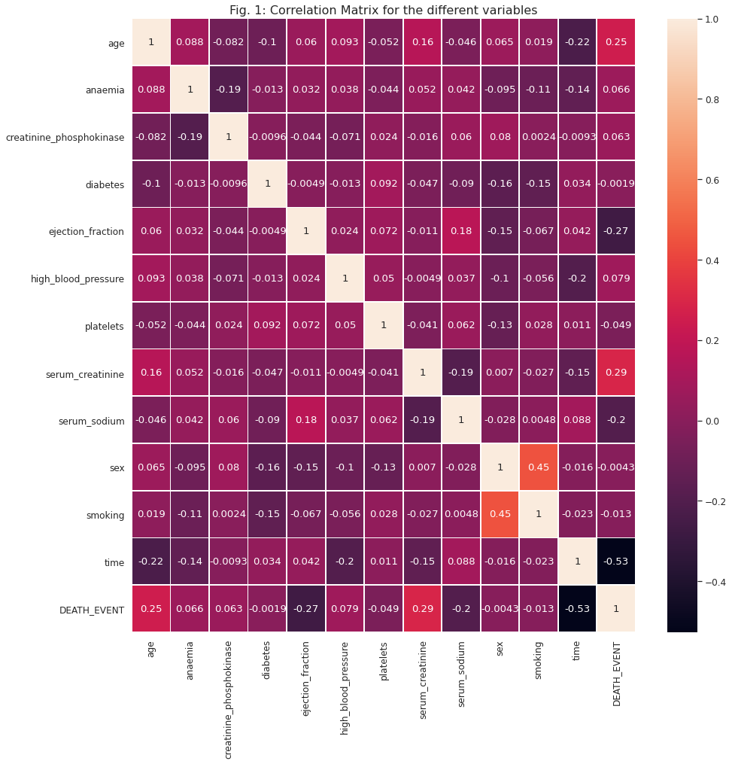
Correlation Matrix
There are no signs of multicollinearity among features.
Serum creatinine, Age highest correlation with target feature DEATH_EVENT
Time and ejection fraction is negative relation with target feature DEATH_EVENT.

Slide 8
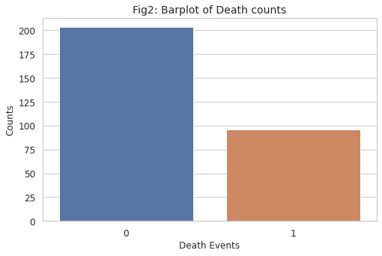
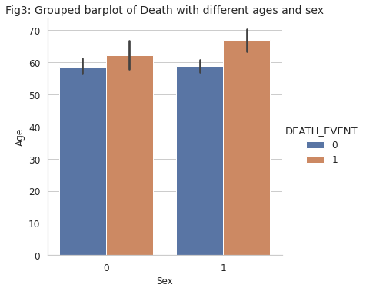
Observations
As shown in fig2, the number of death counts(95) is less than the survival count(210) of the patients. We can interpret that the there are more survival rate of the patients as compared to the death rate.
As shown in fig3, there are higher deaths in male(Sex= 1) as compared to the female above 6o years of age. While survival rate of the both the sexes are approximately same.

Slide 9
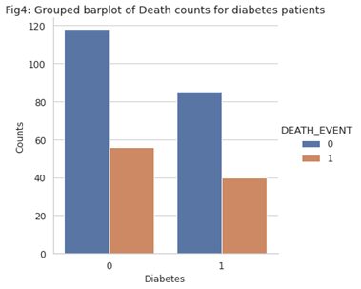
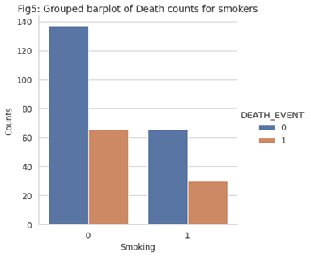
Observations
As shown in fig4, the survival rate of the non-diabetic patients(118) are higher than the diabetic patients(85). While death count of the non-diabetic patients are more than the diabetic patients who died from heart fail. So, we can not say that diabetic patients have higher death count due to heart fail.
As shown in fig5, the survival count of the people(138) who does not smokes are higher than the people who smokes(65). While death count of the people(65) who does not smokes are more than the people who smokes and died from heart fail. So, we can say that death rate of the people does not depend upon smoking.

Slide 10
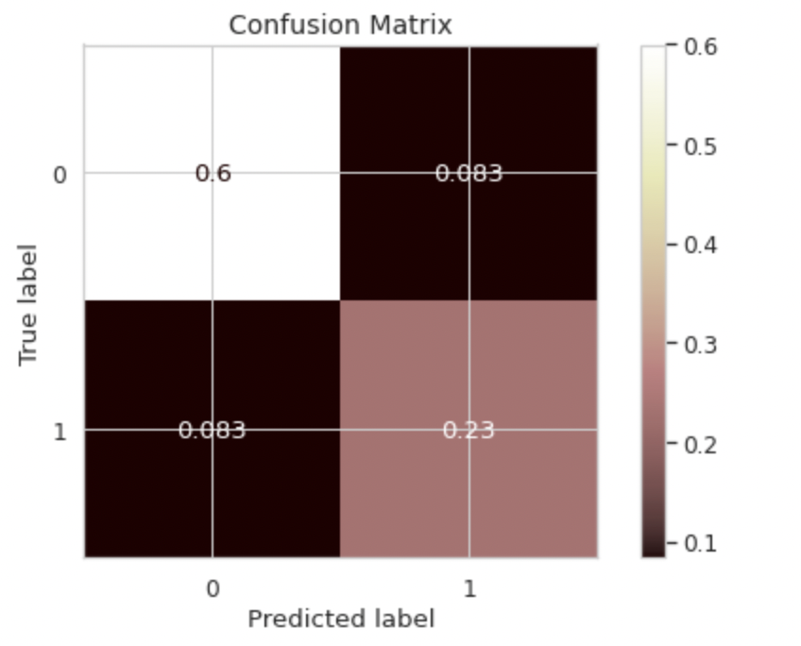
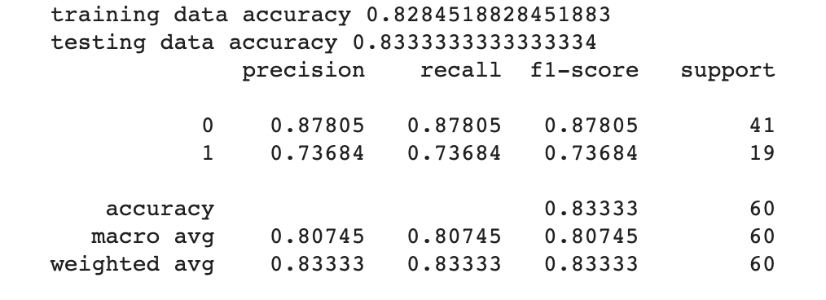
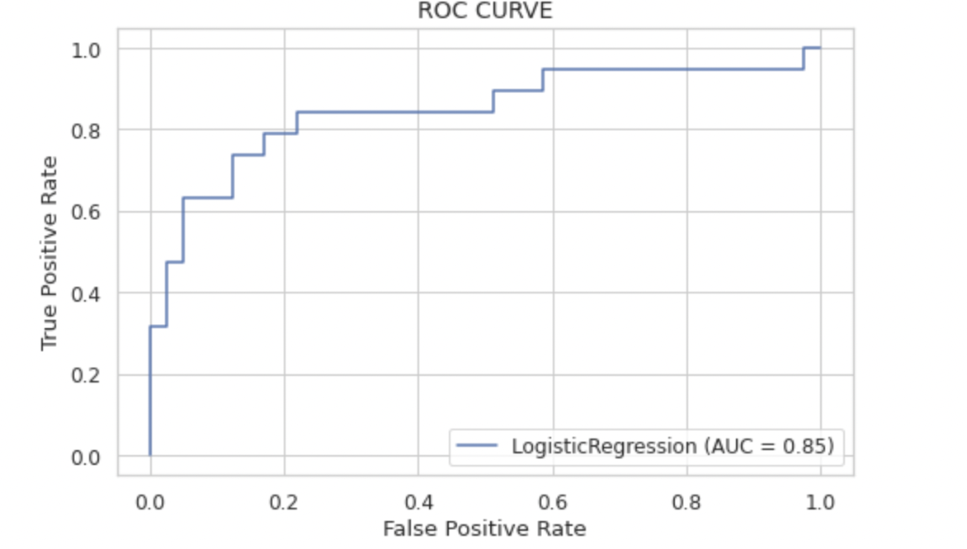
Evaluating Logistic Regression Model Performance

Slide 11
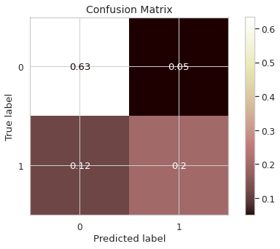
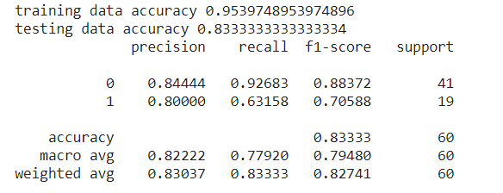
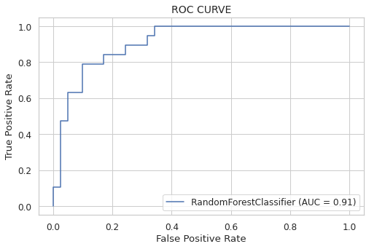
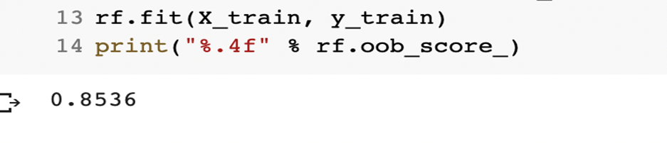
Evaluating Random Forest Model Performance

Slide 12
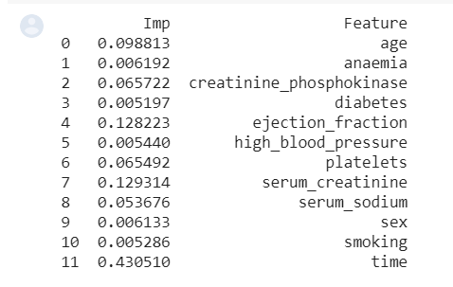
Observations
time,ejection_fraction and serum_creatinine are most important feature
training accuracy is 95% and testing accuracy is 83% which seems ok and there is no sign of overfitting
Area under curve is 91%

Slide 13

Conclusion
Most important feature is serum_creatinine and ejection_fraction after time.
We can infer that the survival count is more than the death count due to heart fail.
We can conclude that there are higher number of deaths in male patients as compared to the female patients above 60 years of age. While survival rate of the both the sexes patients are approximately same.
We can infer from the above observations that smoking and diabetes does not affect the heart fail of the patients. As patients having diabetes and who smokes survived from the heart attack most than the death.
We can observe that patients with ages 50, 60, 70 years are having high heart failure than others and patients with age 87 to 90 years have the minimum heart rate failure.
Based on the model prediction and feature importance we can say that doctors may focus on seerum_creatinine and ejection fraction
Time is also one of the most important feature. This shows timely medical help, and enough observation period may help to reduce death caused by heart failure

Slide 14
Appendix
Dataset, Heart Failure, UCI: http://archive.ics.uci.edu/ml/datasets/Heart+failure+clinical+records#
Heart Failure Prediction(artical number-16), 03 Feb 2020, BMC: https://bmcmedinformdecismak.biomedcentral.com/articles/10.1186/s12911-020-1023-5#Tab1
Better Heatmaps and Correlation Matrix Plots in Python(Drazen Zaric 15 Apr, 2019) Towards data science: https://towardsdatascience.com/better-heatmaps-and-correlation-matrix-plots-in-python-41445d0f2bec
Learning Model Building in Scikit-learn(6 Aug, 2019) Geeksforgeeks: https://www.geeksforgeeks.org/learning-model-building-scikit-learn-python-machine-learning-library/
Heart Disease UCI-Diagnosis & Prediction, Hardik Deshmukh(18 Jun,2020) towards data science: https://towardsdatascience.com/heart-disease-uci-diagnosis-prediction-b1943ee835a7#a3db

Slide 15

Thank You

